Slide 1
CSI1003 Formal Languages and Automata Theory
MODULE - 6
Dr. WI. Sureshkumar
Associate Professor
School of Computer Science and Engineering (SCOPE)
VIT Vellore
wi.sureshkumar@vit.ac.in
SJT413A34

Slide 2
Module -6
Turing Machine:
Turing Machines as acceptor and transducer
Multi head and Multi tape Turing Machines
Universal Turing Machine
The Halting problem
Turing-Church thesis

Slide 3
Module -7
Recursive and Recursively Enumerable Languages:
Recursive and Recursively Enumerable Languages
Language that is not Recursively Enumerable (RE)
Computable functions
Chomsky Hierarchy
Undecidable problems
Post’s Correspondence Problem

Slide 4
Turing Machine
FSA REG Type – 3
PDA CFL Type – 2
LBA CSL Type – 1
TM RE Type – 0
Alan Turing , 1936 published a landmark paper
Proposed most widely accepted formal model for algorithmic computation
Proved the existence of computationally unsolved problems
Proved the existence of universal Turing machine

Slide 5
Turing Machine
A Turing machine (TM) is a finite state machine with an infinite tape from which it reads its input and on it records its computation.
Turing machine has both accept and reject states.
Comparing TM and a FSA and PDA
A TM may both read from and write its input tape
A TM may move both left and right over its working storage (tape)
A TM halts immediately when it reaches an accept or reject state
can not accepted by FSA but PDA and TM
can accept
can not accepted by both FSA and
PDA but TM can accept.

Slide 6
Turing Machine
TM as an acceptor
After reading the string it is in final state then accept otherwise
reject
TM as a computing device (Transducer)
Starting with a non-blank portion as an input when it halts the non-
blank portion is the output

Slide 7
Turing Machine
A Turing machine (TM) is defined by a 7-tuple
M = (Q, Σ, Γ, δ, q₀, B, F), where
Q - is a finite set of states
Σ - is a finite set of input symbols
Γ - is a finite set of tape symbols, Σ ⊆ Γ
q₀ ∈ Q - is the start state (initial state)
B∈ Γ - is the blank symbol
F ⊆ Q - is the set of accept states (final states)
δ : Q × Γ → Q × Γ × {L, R}
In some formulation the head remains stationary
δ : Q × Γ → Q × Γ × {L, R, S}

Slide 8
Instantaneous Description
An Instantaneous Description (ID) of a Turing machine is a string of the form α₁qα₂ , where α₁ , α₂ ∈ Γ* , q ∈Q.
This means that at that particular instance α₁α₂ is the content of the TM. q is the current state and the tape head points to the first symbol of α₂
The relationship between IDs can be described as follows:
If X₁ X₂ . . . . X_{i-1} q X_{i} X_{i+1} . . . . X_{n} is an ID and δ(q, X_{i}) = (p, Y, R) then the next ID will be
X₁ X₂ . . . . X_{i-1} Y p X_{i+1} . . . . X_{n}
If δ(q, X_{i}) = (p, Y, L) then the next ID will be
X₁ X₂ . . . . pX_{i-1} Y X_{i+1} . . . . X_{n}

Slide 9
Instantaneous Description
q X₁ X₂ . . . . X_{i-1} X_{i} X_{i+1} . . . . X_{n} is the initial ID
ID₀ Ⱶ ID₁ Ⱶ . . . . Ⱶ ID_{n} is denoted by
ID₀ Ⱶ* ID_{n}
Ⱶ* is a reflexive transitive closure of Ⱶ
A string w is accepted by the TM M = (Q, Σ, Γ, δ, q₀, B, F) if
q₀ w Ⱶ* α₁q_{f} α₂ for some α₁ , α₂ ∈ Γ* , q_{f} ∈F.
The language accepted by the TM M is defined as
T(M) = { w / w∈ Σ* , q₀ w Ⱶ* α₁q_{f} α₂ for some α₁ , α₂ ∈ Γ* , q_{f} ∈F }

Slide 10
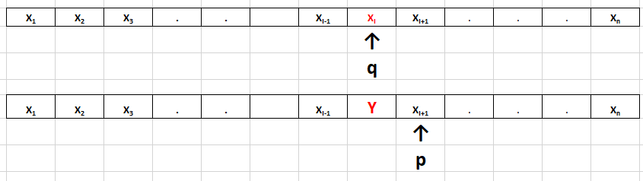
If X₁ X₂ . . . . X_{i-1} q X_{i} X_{i+1} . . . . X_{n} is an ID and δ(q, X_{i}) = (p, Y, R) then the next ID will be
X₁ X₂ . . . . X_{i-1} Y p X_{i+1} . . . . X_{n}

Slide 11
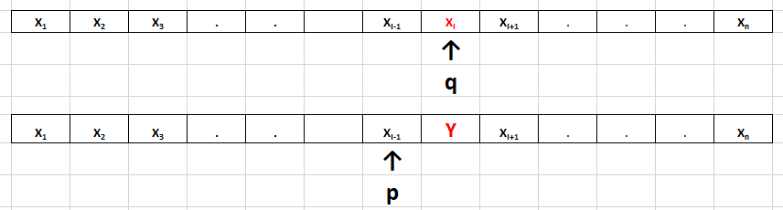
If δ(q, X_{i}) = (p, Y, L) then the next ID will be
X₁ X₂ . . . . pX_{i-1} Y X_{i+1} . . . . X_{n}

Slide 12
Instantaneous Description
q X₁ X₂ . . . . X_{i-1} X_{i} X_{i+1} . . . . X_{n} is the initial ID
ID₀ Ⱶ ID₁ Ⱶ . . . . Ⱶ ID_{n} is denoted by
ID₀ Ⱶ* ID_{n}
Ⱶ* is a reflexive transitive closure of Ⱶ
A string w is accepted by the TM M = (Q, Σ, Γ, δ, q₀, B, F) if
q₀ w Ⱶ* α₁q_{f} α₂ for some α₁ , α₂ ∈ Γ* , q_{f} ∈F.
The language accepted by the TM M is defined as
T(M) = { w / w∈ Σ* , q₀ w Ⱶ* α₁q_{f} α₂ for some α₁ , α₂ ∈ Γ* , q_{f} ∈F }

Slide 13
Example-1
Construct a TM which will accept the language L = { a^{n}b^{n} / n ≥ 1}
M = (Q, Σ, Γ, δ, q₀ , B , F), where
Q = {q₀ , q₁ , q₂ , q₃ , q₄} , Σ = {a , b} , Γ ={X , Y , a , b , B} , F = { q₄ }
δ(q₀ , a ) = (q₁ , X , R )
δ(q₁ , a ) = (q₁ , a , R )
δ(q₁ , Y ) = (q₁ , Y , R )
δ(q₁ , b ) = (q₂ , Y , L)
δ(q₂ , Y ) = (q₂ , Y , L)
δ(q₂ , a ) = (q₂ , a , L )
δ(q₂ , X ) = (q₀ , X , R )
δ(q₀ , Y ) = (q₃ , Y , R )
δ(q₃ , Y ) = (q₃ , Y , R )
δ(q₃ , B ) = (q₄ , B , L )

Slide 14
q₀aabb Ⱶ Xq₁abb Ⱶ Xaq₁bb Ⱶ Xq₂aYb Ⱶ q₂XaYb Ⱶ X q₀aYb Ⱶ XXq₁Yb
Ⱶ XXYq₁b Ⱶ XXq₂YY Ⱶ Xq₂XYY Ⱶ XXq₀YY Ⱶ XXYq₃Y Ⱶ XXYYq₃B Ⱶ XXYq₄Y
Y / Y , R
Y / Y , R
a / a , R
Y / Y , L
Y / Y , R
a / a , L
a / X , R
b / Y , L
B / B , L
q₀
q₁
q₂
q₃
q₄
X / X , R

Slide 15
Example:2 Given two positive integers x and y, design a TM that computes x + y
First represent x and y in unary.
w(x), w(y) ∈ {1}⁺ such that |w(x)|= x and |w(y)|= y
q₀ w(x)0w(y) Ⱶ* q_{f} w(x + y)0
x = 3 , y =2
w(x) = 111 and w(y) = 11
q₀111011 Ⱶ* q_{f}111110

Slide 16
M = (Q, Σ, Γ, δ, q₀ , B , F), where
Q = {q₀ , q₁ , q₂ , q₃ , q₄} , Σ = {1} , Γ ={0, 1, B} , F = { q₄ }
δ(q₀ , 1 ) = (q₀ , 1 , R )
δ(q₀ , 0 ) = (q₁ , 1 , R )
δ(q₁ , 1 ) = (q₁ , 1 , R )
δ(q₁ , B ) = (q₂ , B , L)
δ(q₂ , 1 ) = (q₃ , 0 , L)
δ(q₃ , 1 ) = (q₃ , 1 , L )
δ(q₃ , B ) = (q₄ , B , R )
q₀111011 Ⱶ 1q₀11011 Ⱶ 11q₀1011 Ⱶ 111q₀011 Ⱶ 1111q₁11 Ⱶ 11111q₁1
Ⱶ 111111q₁B Ⱶ 11111q₂1B Ⱶ 1111q₃10 Ⱶ 111q₃110 Ⱶ 11q₃1110
Ⱶ 1q₃11110 Ⱶ q₃111110 Ⱶ q₃B111110 Ⱶ Bq₄111110

Slide 17
Example-2
Construct a TM which will accept the language L = { a^{n}b^{n}c^{n} / n ≥ 1}
M = (Q, Σ, Γ, δ, q₀ , B , F), where Q = {q₀ , q₁ , q₂ , q₃ , q₄ , q₅} ,
Σ = {a , b , c} , Γ ={X , Y , Z, a , b , c , B} , F = { q₅ }
δ(q₀ , a ) = (q₁ , X , R ) δ(q₃ , X ) = (q₀ , X , R )
δ(q₁ , a ) = (q₁ , a , R ) δ(q₀ , Y ) = (q₄ , Y , R )
δ(q₁ , Y ) = (q₁ , Y , R ) δ(q₄ , Y ) = (q₄ , Y , R )
δ(q₁ , b ) = (q₂ , Y , R) δ(q₄ , Z ) = (q₄ , Z , R )
δ(q₂ , b ) = (q₂ , b , R) δ(q₄ , B ) = (q₅ , B , L )
δ(q₂ , Z ) = (q₂ , Z , R)
δ(q₂ , c ) = (q₃ , Z , L )
δ(q₃ , Z ) = (q₃ , Z , L )
δ(q₃ , b ) = (q₃ , b , L )
δ(q₃ , Y ) = (q₃ , Y , L )
δ(q₃ , a ) = (q₃ , a , L )

Slide 18
Example-3
Construct a TM which will convert unary to binary
M = (Q, Σ, Γ, δ, q₀ , B , F), where Q = {q₀ , q₁ , q₂ , q₃ , q₄ , q₅} ,
Σ = {a , b , c} , Γ ={X , Y , Z, a , b , c , B} , F = { q₅ }
δ(q₀ , a ) = (q₁ , X , R ) δ(q₃ , X ) = (q₀ , X , R )
δ(q₁ , a ) = (q₁ , a , R ) δ(q₀ , Y ) = (q₄ , Y , R )
δ(q₁ , Y ) = (q₁ , Y , R ) δ(q₄ , Y ) = (q₄ , Y , R )
δ(q₁ , b ) = (q₂ , Y , R) δ(q₄ , Z ) = (q₄ , Z , R )
δ(q₂ , b ) = (q₂ , b , R) δ(q₄ , B ) = (q₅ , B , L )
δ(q₂ , Z ) = (q₂ , Z , R)
δ(q₂ , c ) = (q₃ , Z , L )
δ(q₃ , Z ) = (q₃ , Z , L )
δ(q₃ , b ) = (q₃ , b , L )
δ(q₃ , Y ) = (q₃ , Y , L )
δ(q₃ , a ) = (q₃ , a , L )

Slide 19
Example-4
Design a TM to make a copy of a string over {0, 1}.
Input: B1100#B Output : B1100#1100B
M = (Q, Σ, Γ, δ, q₀ , B , F), where
Q = {q₀ , q₁ , q₂ , q₃ , q₄} , Σ = {0, 1} , Γ ={0, 1, #, X, Y, B} , F = { q₄ }
δ(q₀ , 0 ) = (q₁ , X , R ) δ(q₀ , 1 ) = (q₂ , Y , R )
δ(q₁ , 0 ) = (q₁ , 0 , R ) δ(q₂ , 0 ) = (q₂ , 0 , R )
δ(q₁ , 1 ) = (q₁ , 1 , R ) δ(q₂ , 1 ) = (q₂ , 1 , R )
δ(q₁ , # ) = (q₁ , # , R) δ(q₂ , # ) = (q₂ , # , R)
δ(q₁ , B ) = (q₃ , 0 , L) δ(q₂ , B ) = (q₃ , 1 , L)
δ(q₃ , 0 ) = (q₃ , 0 , L ) δ(q₃ , 1 ) = (q₃ , 1 , L )
δ(q₃ , # ) = (q₃ , # , L ) δ(q₃ , X ) = (q₀ , 0 , R )
δ(q₃ , Y ) = (q₀ , 1 , R ) δ(q₀ , # ) = (q₄ , # , R )

Slide 20
q₀1100# Ⱶ Yq₂100# Ⱶ Y1q₂00# Ⱶ Y10q₂0# Ⱶ Y100q₂# Ⱶ Y100#q₂B
Ⱶ Y100q₃#1Ⱶ Y10q₃0#1 Ⱶ Y1q₃00#1 Ⱶ Yq₃100#1 Ⱶ q₃Y100#1
Ⱶ 1q₀100#1 Ⱶ 1Yq₂00#1 Ⱶ 1Y0q₂0#1 Ⱶ 1Y00q₂#1 Ⱶ 1Y00#q₂1
Ⱶ 1Y00#1q₂B Ⱶ 1Y00# q₃11 Ⱶ 1Y00q₃ #11 Ⱶ 1Y0q₃0#11
Ⱶ 1Yq₃00#11 Ⱶ 1q₃Y00#11 Ⱶ 11q₀00#11 Ⱶ 11Xq₁0#11 Ⱶ 11X0q₁#11
Ⱶ 11X0#q₁11 Ⱶ 11X0#1q₁1 Ⱶ 11X0#11q₁B Ⱶ 11X0#1q₃10
Ⱶ 11X0#q₃110 Ⱶ 11X0q₃#110 Ⱶ 11Xq₃0#110 Ⱶ 11q₃X0#110 Ⱶ 110q₀0#110
Ⱶ 110Xq₁#110 Ⱶ 110X#q₁110 Ⱶ 110X#1q₁10 Ⱶ 110X#11q₁0 Ⱶ 110X#110q₁B
Ⱶ 110X#11q₃00 Ⱶ 110X#1q₃100 Ⱶ 110X#q₃1100
Ⱶ 110Xq₃#1100 Ⱶ 110q₃X#1100 Ⱶ 1100q₀#1100 Ⱶ 1100#q₄1100

Slide 21
Example-5
Design a TM which recognizes palindromes over alphabet {a, b}.
T(M) = { w∈ {a, b}* / w = w^{R} }
abbbba
babbab even length
abbabba
bbababb odd length

Slide 22
M = (Q, Σ, Γ, δ, q₀ , B , F), where Q = {q₀ , q₁ , q₂ , q₃ , q₄ , q₅ , q₆} ,
Σ = {0, 1} , Γ ={0, 1, #, X, Y, B} , F = { q₆ }
δ(q₀ , a ) = (q₁ , B , R ) δ(q₀ , b ) = (q₄ , B , R )
δ(q₁ , a ) = (q₁ , a , R ) δ(q₄ , a ) = (q₄ , a , R )
δ(q₁ , b ) = (q₁ , b , R ) δ(q₄ , b ) = (q₄ , b , R )
δ(q₁ , B ) = (q₂ , B , L) δ(q₄ , B ) = (q₅ , B , L)
δ(q₂ , a ) = (q₃ , B , L) δ(q₅ , b ) = (q₃ , B , L)
δ(q₃ , a ) = (q₃ , a , L ) δ(q₃ , b ) = (q₃ , b , L )
δ(q₃ , B ) = (q₀ , B , R ) δ(q₀ , B ) = (q₆ , B , R )
δ(q₂ , B ) = (q₆ , B , R ) δ(q₅ , B ) = (q₆ , B , R )

Slide 23
q₀abbbba Ⱶ Bq₁bbbba Ⱶ Bbq₁bbba Ⱶ Bbbq₁bba Ⱶ Bbbbq₁ba
Ⱶ Bbbbbq₁a Ⱶ Bbbbbaq₁B Ⱶ Bbbbbq₂a Ⱶ Bbbbq₃bB Ⱶ Bbbq₃bbB
Ⱶ Bbq₃bbbB Ⱶ Bq₃bbbbB Ⱶ q₃BbbbbB Ⱶ Bq₀bbbbB Ⱶ BBq₄bbbB
Ⱶ BBbq₄bbB Ⱶ BBbbq₄bB Ⱶ BBbbbq₄B Ⱶ BBbbq₅bB Ⱶ BBbq₃bBB
Ⱶ BBq₃bbBB Ⱶ Bq₃BbbBB Ⱶ BBq₀bbBB Ⱶ BBBq₄bBB Ⱶ BBBbq₄BB
Ⱶ BBBq₅bBB Ⱶ BBq₃BBBB Ⱶ BBBq₀BBB Ⱶ BBBBq₆BB

Slide 24
q₀
b / B , R
a / B , R
a / a , R
a / a , R
b / b , R
B / B , R
b / b , R
q₄
q₁
q₆
B / B , L
B / B , L
B / B , R
B / B , R
q₅
q₂
b / B , L
a / B , L
B / B , R
q₃
a / a , L
b / b , L

Slide 25
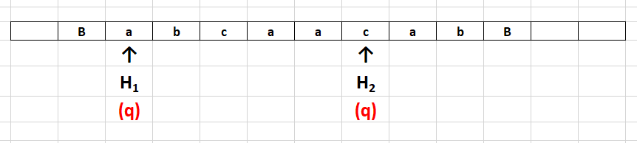
Multi-head Turing Machine
A Turing machine with single tape can have multiple heads.
Let us consider a TM with two heads H₁ and H₂
Each head can capable of performing read / write / move operation independently.

Slide 26
The transition behaviour of 2-head one tape Turing machine can be defined as given below:
δ(q, a, c) = (p, (X, R), (Y, L))
Where
a - symbol under the head H₁
c - symbol under the head H₂
X - symbol to be written in the cell under H₁
Y - symbol to be written in the cell under H₂

Slide 27
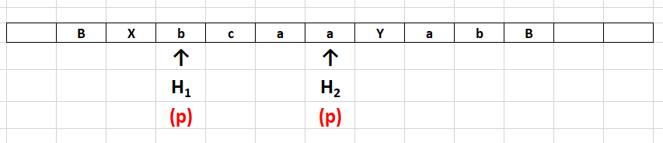

Slide 28
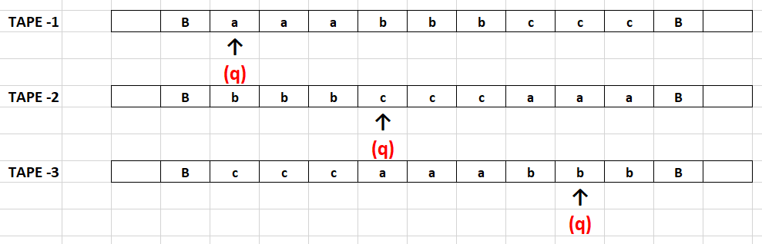
Multi-tape Turing Machine
Multi – tape Turing machine has multiple tapes (more than one but finite number of tapes) with each tape having its own independent head.
Let us consider the case of three tape TM.

Slide 29
The transition behaviour of 3-tape Turing machine can be defined as given below:
δ(q, a, c, b) = (p, (X, R), (Y, L), (Z, R))
Where
q - current state
p - next state
a - symbol under the head on tape 1
c - symbol under the head on tape 2
b - symbol under the head on tape 3
X - symbol to be written in the cell on tape 1
Y - symbol to be written in the cell on tape 2
Z - symbol to be written in the cell on tape 3

Slide 30
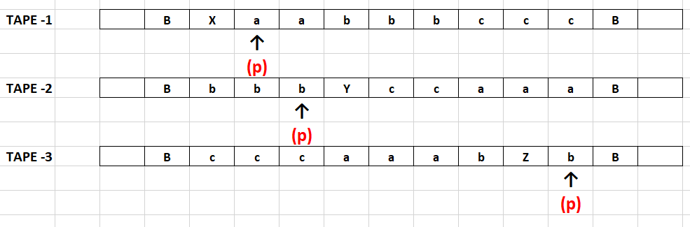

Slide 31
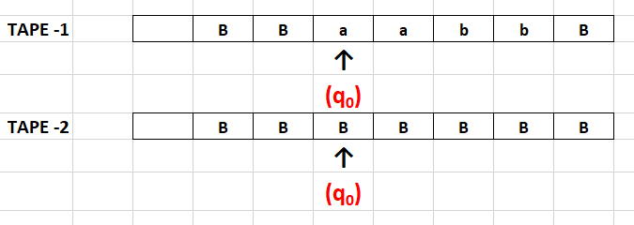
Example: Construct a two tape Turing machine to convert an input w into ww^{R}
Initial configuration:

Slide 32
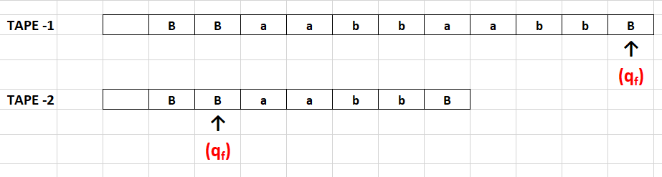
Final configuration:

Slide 33
δ(q₀, a, B) = (q₀, (a, R), (a, R))
δ(q₀, b, B) = (q₀, (b, R), (b, R))
δ(q₀, B, B) = (q₁, (B, N), (B, L))
δ(q₁, B, a) = (q₁, (a, R), (a, L))
δ(q₁, B, b) = (q₁, (b, R), (b, L))
δ(q₁, B, B) = (q₂, (B, N), (B, N))
(B / a , R)
(a / a , L)
(a / a , R)
(B / a , R)
(B / b , R)
(b / b , L)
(b / b , R)
(B / b , R)
(B / B , N)
(B / B , N)
q₀
q₁
q₂
(B / B , L)
(B / B , N)

Slide 34
Recursive and Recursively Enumerable Languages
Def: 1
The language accepted by a Turing machine (TM) is called recursively enumerable set (RE).
Def: 2
The language accepted by a Turing machine (TM) which halts on all inputs is called recursive set (Rec).

Slide 35
Chomsky Hierarchy
Non-recursively enumerable
Recursively-enumerable
Recursive
Context-sensitive
Context-free
Regular

Slide 36
Properties of recursive and recursively enumerable sets
The union of two recursive sets is recursive.
The union of two recursively enumerable sets is recursively enumerable.
The complement of recursive set is recursive.
If L and L’ are recursively enumerable, then L is recursive.

Slide 37
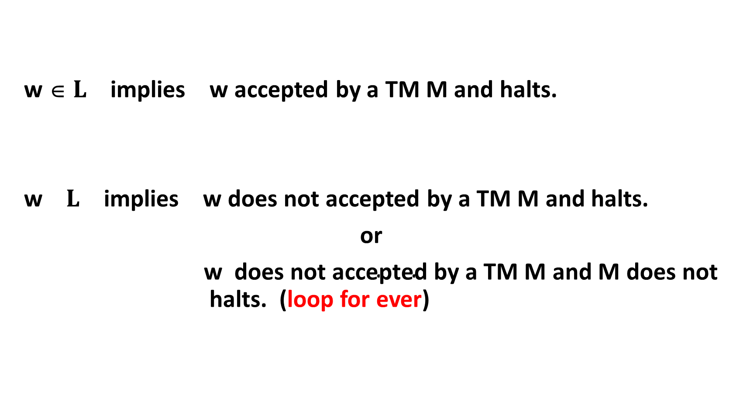
w ∈ $L$ implies w accepted by a TM M and halts.
w $L$ implies w does not accepted by a TM M and halts.
or
$\text{w} \text{does} \text{not} \text{accepted} \text{by} \text{a} \text{TM} \text{M} \text{and} \text{M} \text{does} \text{not} \text{halts}\text{.}$ (loop for ever)

Slide 38
1) The union of two recursive sets is recursive.
Proof:
Let L1 and L2 are two recursive sets.
Yes
w
M1
No
Yes
w
M2
No

Slide 39
M accepts L₁ U L₂ , it is a recursive set. (Since it halts for all inputs)
Yes
w
M1
No
Yes
M2
No
M

Slide 40
2) The union of two recursively enumerable sets is recursively enumerable.
Proof:
Let L1 and L2 are two recursively enumerable sets.
Yes
w
M1
Yes
w
M2

Slide 41
M accepts L₁ U L₂ , it is a recursive enumerable set.
Yes
M1
w
Yes
M2
M

Slide 42
3) The complement of recursive set is recursive.
Proof:
Let L is recursive set.
Yes
w
M
No

Slide 43
M’ accepts L’ , it is a recursive set.
Yes
No
w
M
No
Yes
M’

Slide 44
4) If L and L’ are recursively enumerable, then L is recursive.
Proof:
Let L and L’ are two recursively enumerable sets.
Yes
w
M
Yes
w
M’

Slide 45
M’’ accepts L , it is a recursive set (Since it halts for all inputs).
Yes
M
w
Yes
No
M’
M’’

Slide 46
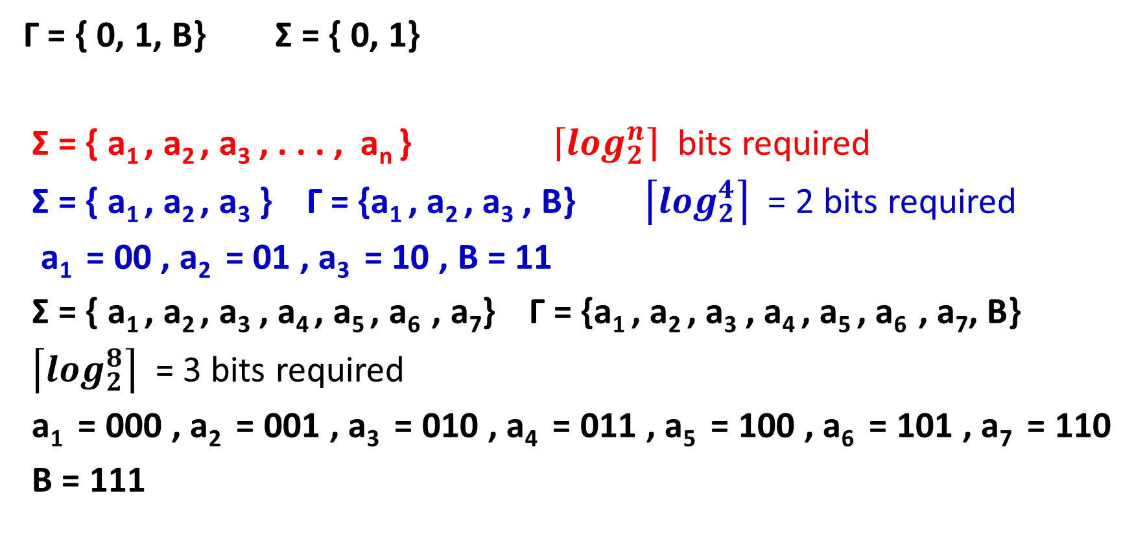
Two symbols are enough (apart from blank symbol)
Γ = { 0, 1, B} Σ = { 0, 1}
Σ = { a₁ , a₂ , a₃ , . . . , a_{n} } $\left\lceil \log_{2}^{n}\right\rceil$ bits required
Σ = { a₁ , a₂ , a₃ } Γ = {a₁ , a₂ , a₃ , B} $\left\lceil \log_{2}^{4}\right\rceil$ = 2 bits required
a₁ = 00 , a₂ = 01 , a₃ = 10 , B = 11
Σ = { a₁ , a₂ , a₃ , a₄ , a₅ , a₆ , a₇} Γ = {a₁ , a₂ , a₃ , a₄ , a₅ , a₆ , a₇, B}
$\left\lceil \log_{2}^{8}\right\rceil$ = 3 bits required
a₁ = 000 , a₂ = 001 , a₃ = 010 , a₄ = 011 , a₅ = 100 , a₆ = 101 , a₇ = 110
B = 111

Slide 47
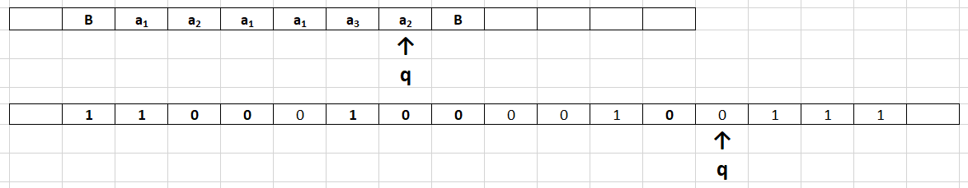

Slide 48
Encoding of Turing machine
M = (Q, Σ, Γ, δ, q₁, B, F) where
Q = {q₁ , q₂ , q₃ , . . . , q_{n} } q₁ – initial state
Γ = { 0, 1, B} Σ = { 0, 1}
δ(q_{i} , X_{j} ) = (q_{k} , X_{l} , L/R ) X₁ = 0 , X₂ = 1 , X₃ = B
L = 1 , R = 2
1 ≤ i, k ≤ n , 1 ≤ j, l ≤ 3 , 1 ≤ m ≤ 2
0^{i} 1 0^{j} 1 0^{k} 1 0^{l} 1 0^{m}
111 0^{i} 1 0^{j} 1 0^{k} 1 0^{l} 1 0^{m} 11 0^{i} 1 0^{j} 1 0^{k} 1 0^{l} 1 0^{m} 11 . . . 11 . . . 11 . . . 111

Slide 49
Consider the following Turing machine with alphabet { 0, 1, B} and state set {q₁ , q₂ , q₃ , q₄ , q₅ }, q₁ is the initial state, q₅ is the final state and the transitions are
δ(q₁ , 0 ) = (q₂ , 0 , R ) δ(q₃ , B ) = (q₄ , 1 , R )
δ(q₂ , 0 ) = (q₃ , 0 , R ) δ(q₄ , 0 ) = (q₃ , 1 , L )
δ(q₃ , 0 ) = (q₄ , 1 , R ) δ(q₄ , 1 ) = (q₅ , 1 , R )
δ(q₃ , 1 ) = (q₄ , 1 , L) δ(q₄ , B ) = (q₃ , 1 , L)
1110¹ 1 0¹ 1 0² 1 0¹ 1 0² 110² 1 0¹ 1 0³ 1 0¹ 1 0² 11 0³ 1 0¹ 1 0⁴ 1 0² 1 0² 11
0³ 1 0² 1 0⁴ 1 0² 1 0¹ 11 0³ 1 0³ 1 0⁴ 1 0² 1 0² 11 0⁴ 1 0¹ 1 0³ 1 0² 1 0¹ 11
0⁴ 1 0² 1 0⁵ 1 0² 1 0² 11 0⁴ 1 0³ 1 0³ 1 0² 1 0¹ 111

Slide 50
Enumeration of Turing machine
111m₁11m₂ 11 m₃ 11 m₄11 m₅ 11 m₆11m₇11m₈111
Each m_{i} is of the form 0^{i} 1 0^{j} 1 0^{k} 1 0^{l} 1 0^{m}
i^{th} integer in binary represents i^{th} Turing machine, say T_{i}
1 - T₁
10 - T₂ If the binary integer is not proper encoding, then the
11 - T₃ respective TM with no moves.
100 - T₄
101 - T₅
110 - T₆
111 - T₇
. . . . .
. . . . .

Slide 51
Enumeration of Turing machine
We can talk about i^{th} TM
i^{th} integer in binary represents i^{th} TM
Some Turing machines do not have any moves

Slide 52
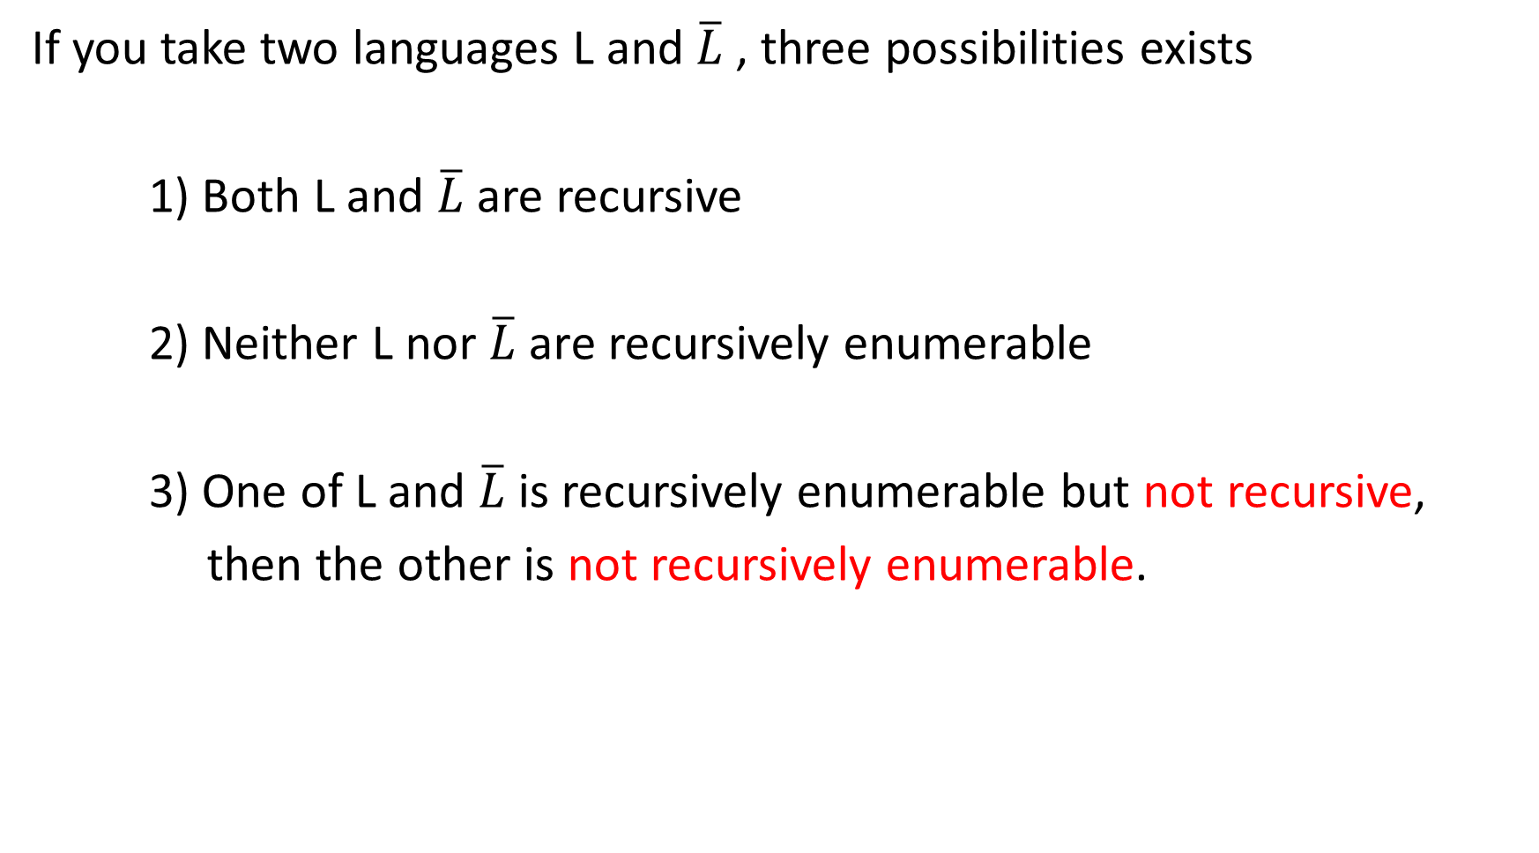
If you take two languages L and $\overline{L}$, three possibilities exists
1) Both L and $\overline{L}$ are recursive
2) Neither L nor $\overline{L} \text{are}$recursively enumerable
3) One of L and $\overline{L} \text{is}$recursively enumerable but not recursive,
then the other is not recursively enumerable.

Slide 53

$\overline{L}$
r.e not r.e r.e not r.e
L
L rec rec
$\overline{L}$
not r.e not r.e
r.e L$\overline{L}$ L$\overline{L}$ $\text{r}\text{.}\text{e}$
rec rec

Slide 54
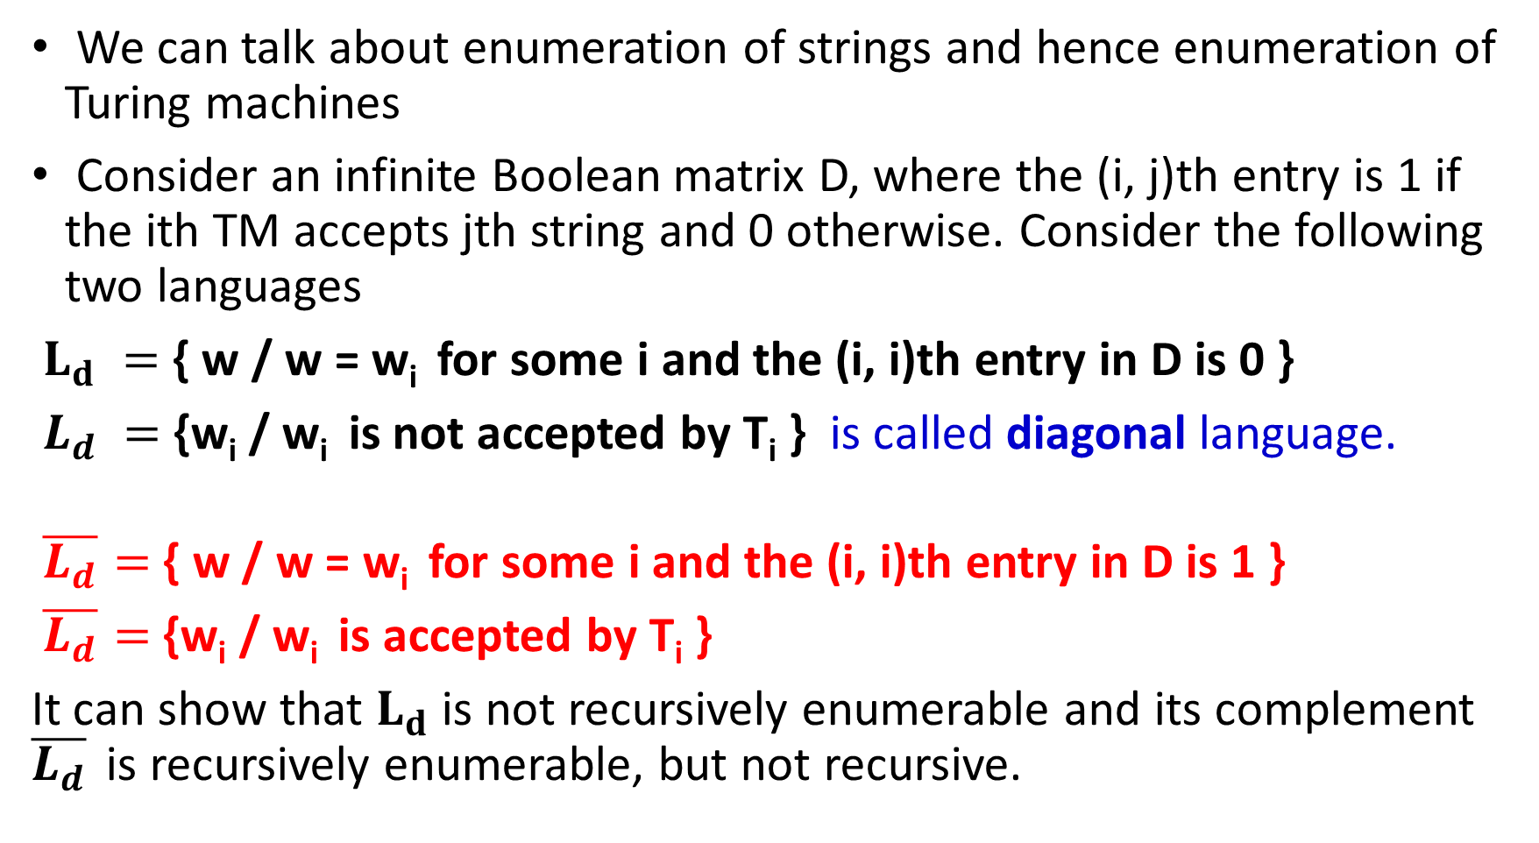
We can talk about enumeration of strings and hence enumeration of Turing machines
Consider an infinite Boolean matrix D, where the (i, j)th entry is 1 if the ith TM accepts jth string and 0 otherwise. Consider the following two languages
$L_{d} =$ { w / w = w_{i} for some i and the (i, i)th entry in D is 0 }
$L_{d} =$ {w_{i} / w_{i} is not accepted by T_{i} } is called diagonal language.
$\overline{L_{d}}$ $=$ { w / w = w_{i} for some i and the (i, i)th entry in D is 1 }
$\overline{L_{d}}$ $=$ {w_{i} / w_{i} is accepted by T_{i} }
It can show that $L_{d}$ is not recursively enumerable and its complement $\overline{L_{d}}$ is recursively enumerable, but not recursive.

Slide 55
w₁ w₂ w₃ w₄ w₅ . . . w_{i} . . .
T₁ 0 1 1 0 1 0 0 1 1 0 1 0
T₂ 1 1 0 1 0
T₃ . . 1 . .
T₄ . . . 0
T₅
.
.
.
T_{i}

Slide 56
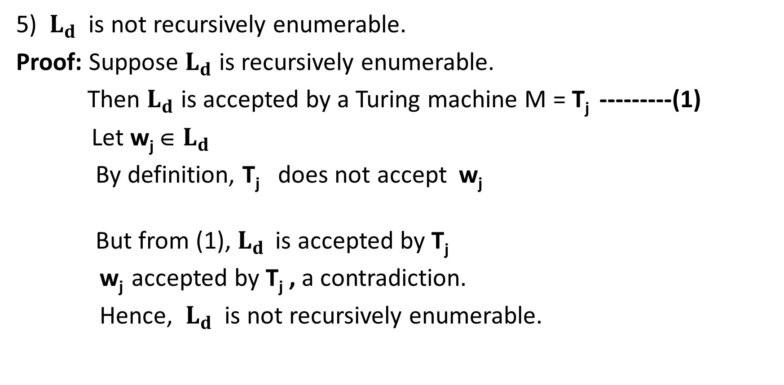
5) ${ L}_{d}$ is not recursively enumerable.
Proof: Suppose $L_{d}$ is recursively enumerable.
Then $L_{d}$ is accepted by a Turing machine M = T_{j} ---------(1)
Let w_{j} ∈ $L_{d}$
By definition, T_{j} does not accept w_{j}
But from (1), $L_{d}$ is accepted by T_{j}
w_{j} accepted by T_{j} , a contradiction.
Hence, ${ L}_{d}$ is not recursively enumerable.

Slide 57
Universal Turing machine (U)
Universal TM is a TM which can simulate any other TM including itself.
Universal TM is denoted by U.
We are considering TMs with tape alphabets {0, 1, B}. Encoding of such TM T is a binary string d_{T} .
U has three tapes. The first tape is represented with d_{T} t that is the encoding of T and the input to T. It will be of the form
111 . . . . . 11 . . . . . 11 . . . . . 11 . . . . . 11 . . . . . 111 t . . . .
Here t is a string over an alphabet {0, 1}

Slide 58
Universal Turing machine (U)
We assume that the states of the TM T are {{q₁ , q₂ , q₃ , . . . , q_{n} } ,
where q₁ is the initial state.
The second tape contains information about the state.
At any instance, T is supposed to be in state q_{i} , 1 ≤ i ≤ n
The universal TM U while simulating TM T will have 0^{i} in tape 2.
Tape 3 is used for simulation.

Slide 59
FC
111 . . . . . 11 . . . . . 11 . . . . . 11 . . . . . 11 . . . . . 111 1100110
000000
1100110

Slide 60
U simulates T on t
halts and accepts halts and rejects gets into a loop

Slide 61
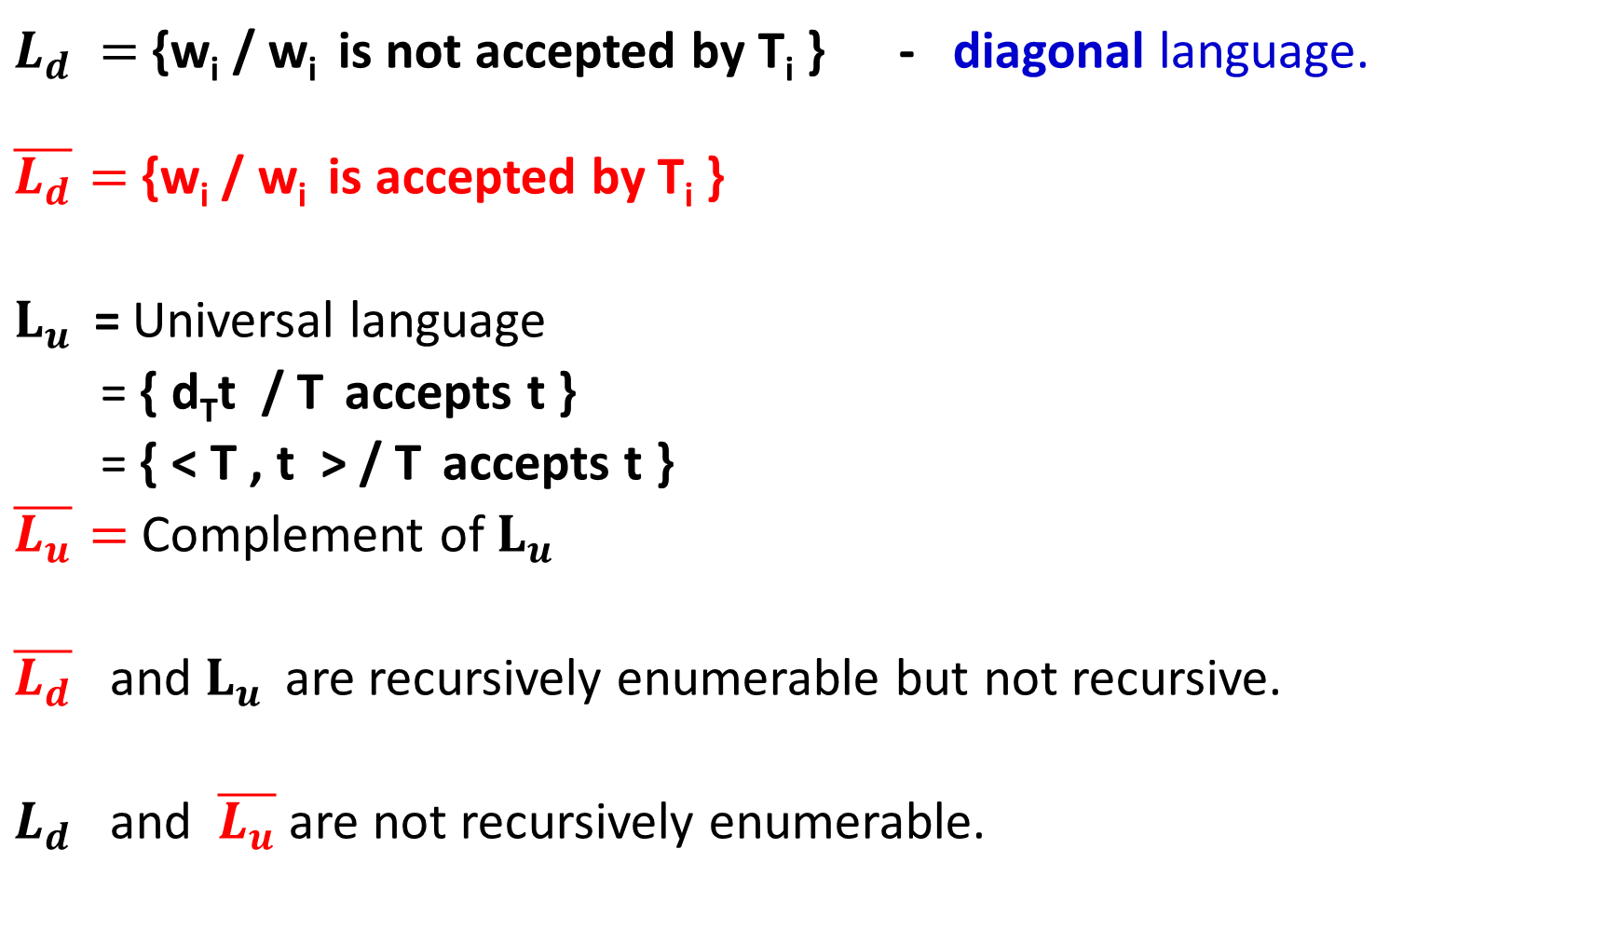
$L_{d} =$ {w_{i} / w_{i} is not accepted by T_{i} } - diagonal language.
$\overline{L_{d}}$ $=$ {w_{i} / w_{i} is accepted by T_{i} }
$L_{u } \text{=}$ Universal language
= { d_{T}t / T accepts t }
= { < T , t > / T accepts t }
$\overline{L_{u}}$ $=$ Complement of $L_{u }$
$\overline{L_{d}}$ and $L_{u }$ are recursively enumerable but not recursive.
$L_{d}$ and $\overline{L_{u}}$ are not recursively enumerable.

Slide 62

not r.e
r.e $L_{d}$ $\overline{L_{u}}$
$L_{u }$ $\overline{L_{d}}$
rec

Slide 63
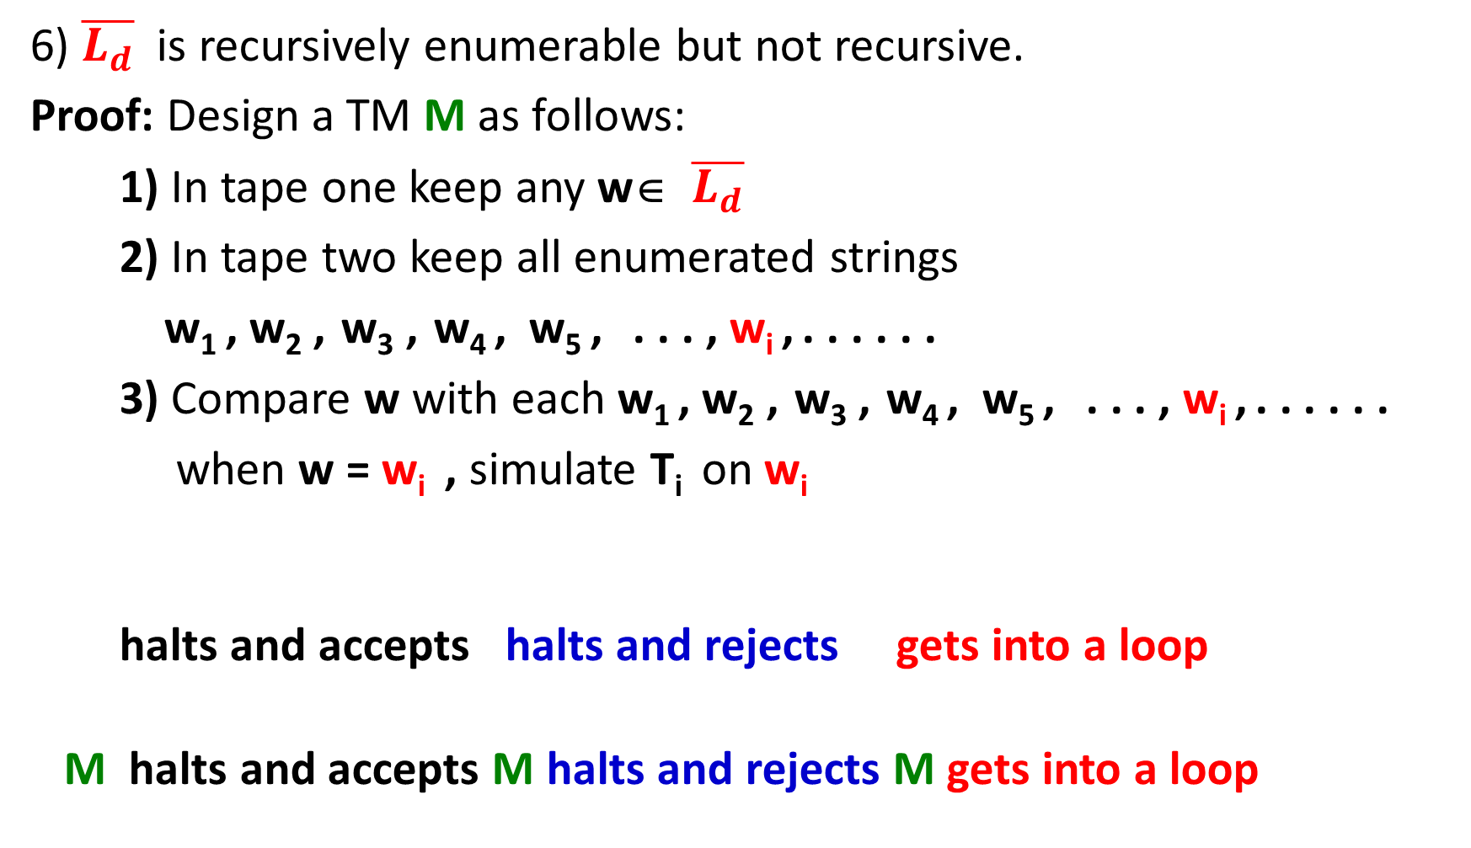
6) $\overline{L_{d}}$ is recursively enumerable but not recursive.
Proof: Design a TM M as follows:
1) In tape one keep any w∈ $\overline{L_{d}}$
2) In tape two keep all enumerated strings
w₁ , w₂ , w₃ , w₄ , w₅ , . . . , w_{i} , . . . . . .
3) Compare w with each w₁ , w₂ , w₃ , w₄ , w₅ , . . . , w_{i} , . . . . . .
when w = w_{i} , simulate T_{i} on w_{i}
halts and accepts halts and rejects gets into a loop
M halts and accepts M halts and rejects M gets into a loop

Slide 64
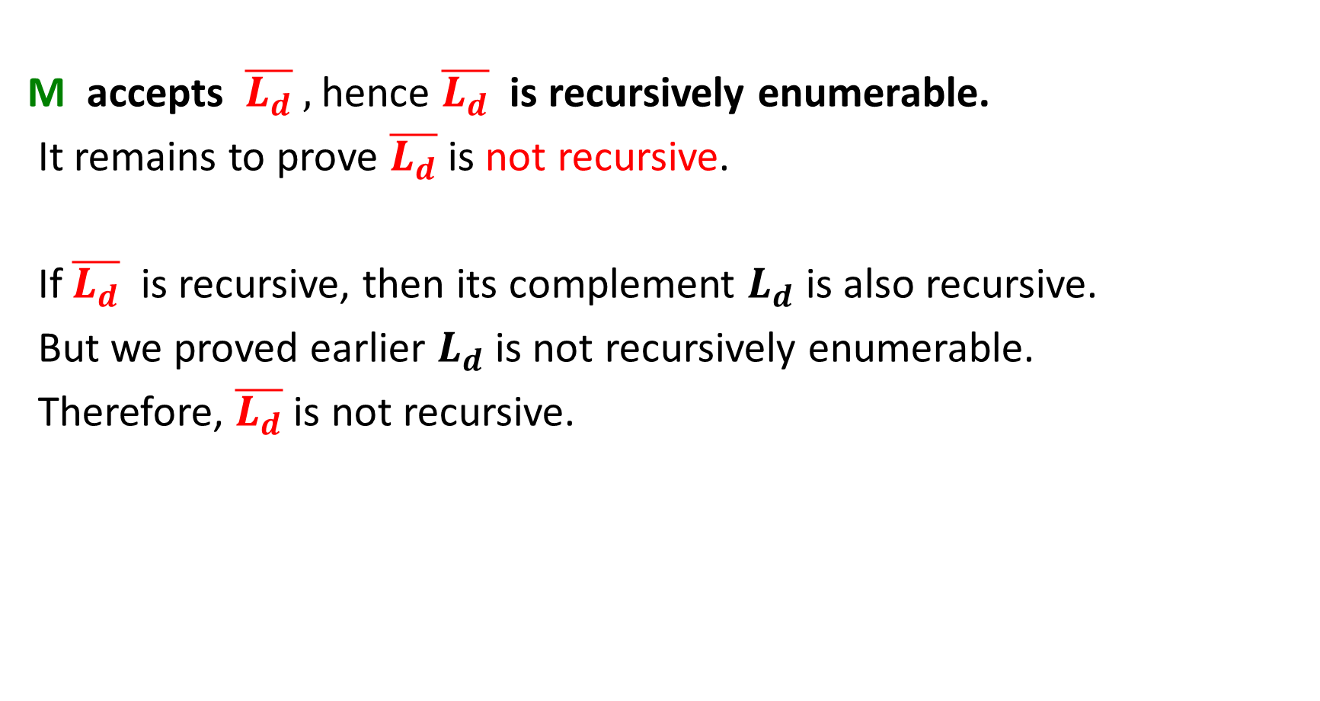
M accepts $\overline{L_{d}} ,$hence $\overline{L_{d}}$ is recursively enumerable.
It remains to prove $\overline{L_{d}}$ is not recursive.
If $\overline{L_{d}}$ is recursive, then its complement $L_{d}$ is also recursive.
But we proved earlier $L_{d}$ is not recursively enumerable.
Therefore, $\overline{L_{d}}$ is not recursive.

Slide 65
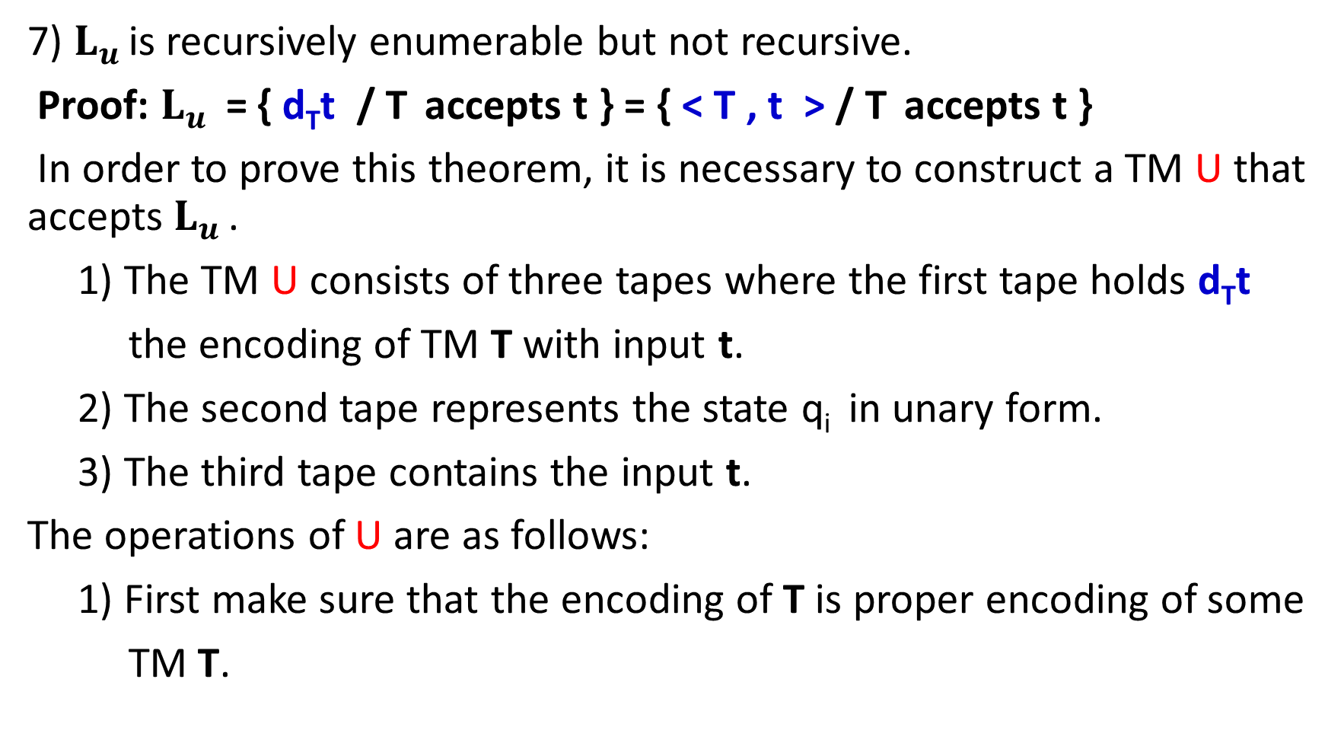
7) $L_{u }$is recursively enumerable but not recursive.
Proof: $L_{u } \text{=}$ { d_{T}t / T accepts t } = { < T , t > / T accepts t }
In order to prove this theorem, it is necessary to construct a TM U that accepts $L_{u }$.
1) The TM U consists of three tapes where the first tape holds d_{T}t
the encoding of TM T with input t.
2) The second tape represents the state q_{i} in unary form.
3) The third tape contains the input t.
The operations of U are as follows:
1) First make sure that the encoding of T is proper encoding of some
TM T.

Slide 66
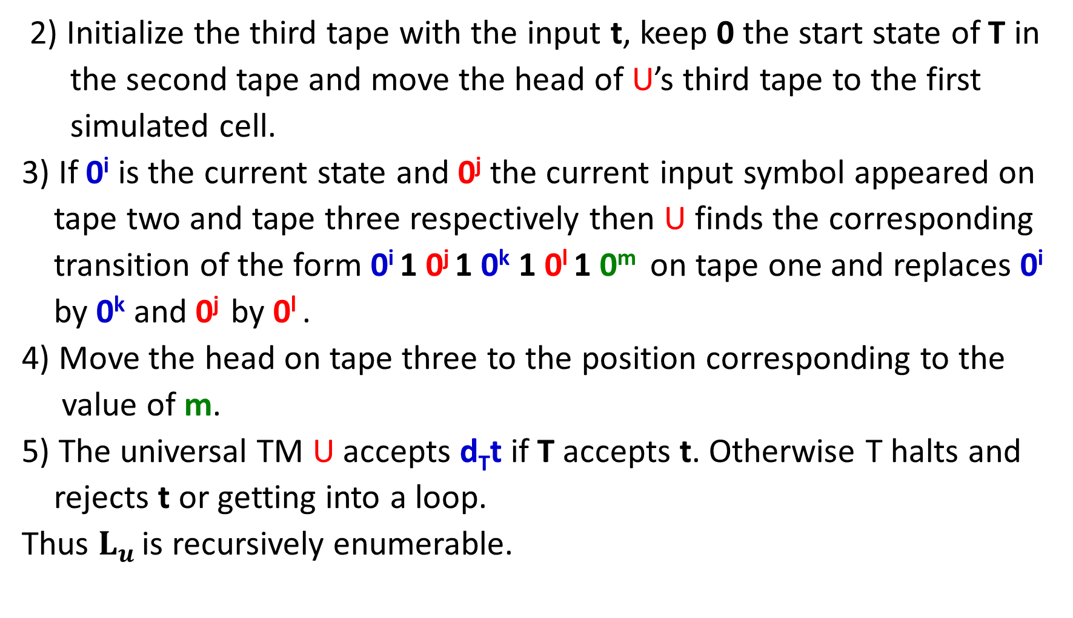
2) Initialize the third tape with the input t, keep 0 the start state of T in
the second tape and move the head of U’s third tape to the first
simulated cell.
3) If 0^{i} is the current state and 0^{j} the current input symbol appeared on
tape two and tape three respectively then U finds the corresponding
transition of the form 0^{i} 1 0^{j} 1 0^{k} 1 0^{l} 1 0^{m} on tape one and replaces 0^{i}
by 0^{k} and 0^{j} by 0^{l} .
4) Move the head on tape three to the position corresponding to the
value of m.
5) The universal TM U accepts d_{T}t if T accepts t. Otherwise T halts and
rejects t or getting into a loop.
Thus $L_{u }$is recursively enumerable.

Slide 67
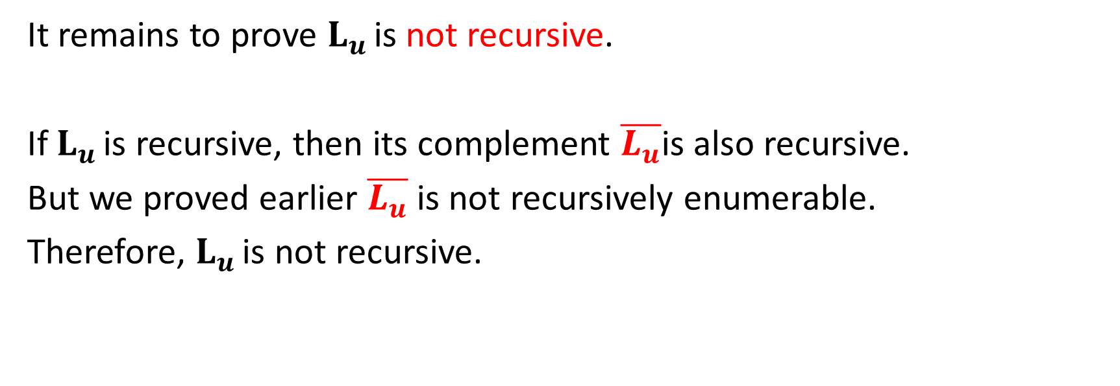
It remains to prove $L_{u }$is not recursive.
If $L_{u }$is recursive, then its complement $\overline{L_{u}}$is also recursive.
But we proved earlier $\overline{L_{u}}$ is not recursively enumerable.
Therefore, $L_{u }$is not recursive.

Slide 68
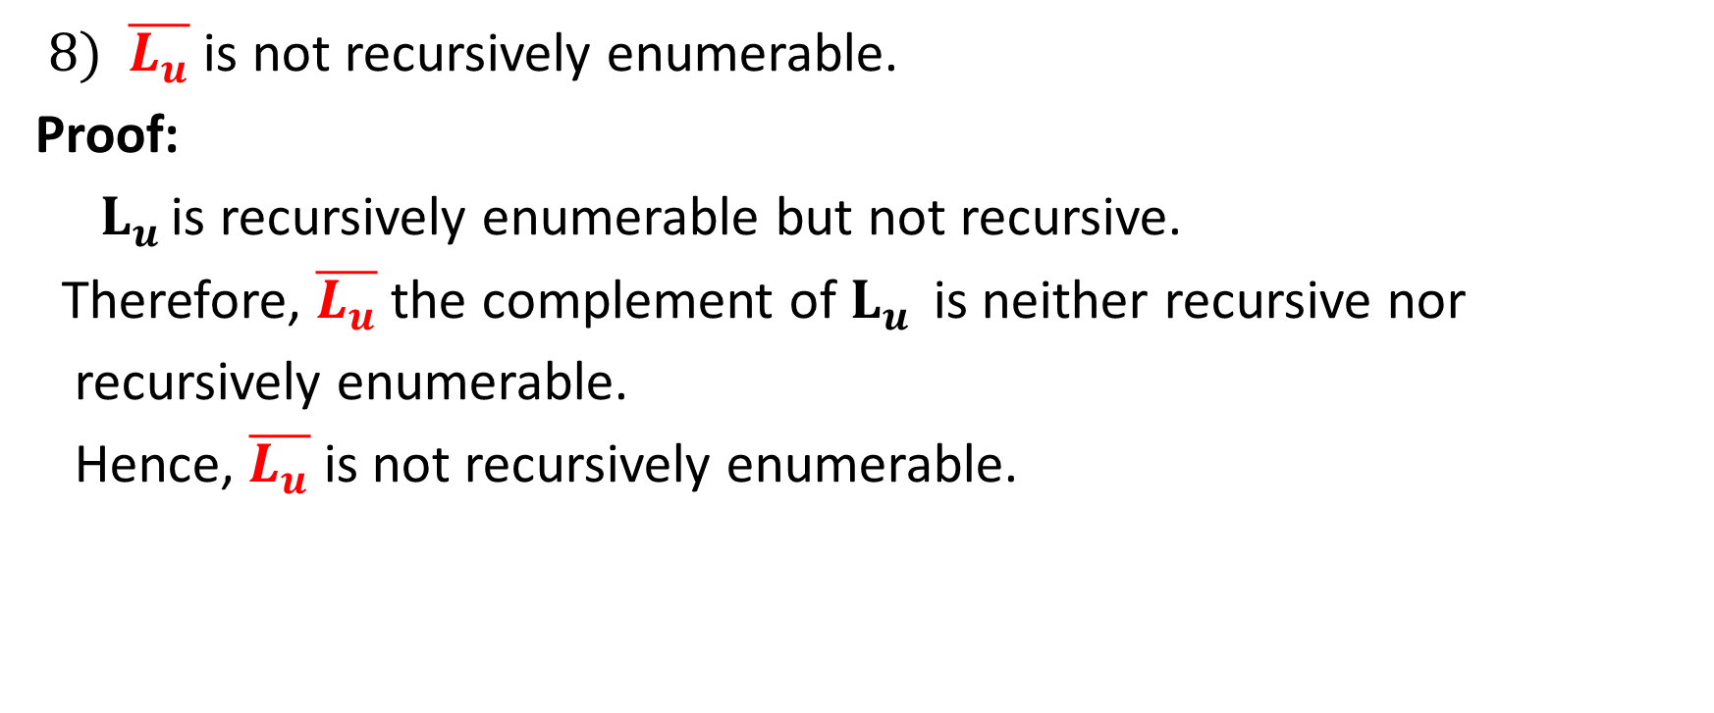
$8) \overline{L_{u}}$ is not recursively enumerable.
Proof:
$L_{u }$is recursively enumerable but not recursive.
Therefore, $\overline{L_{u}}$ the complement of $L_{u }$ is neither recursive nor
recursively enumerable.
Hence, $\overline{L_{u}}$ is not recursively enumerable.

Slide 69
Halting Problem
The halting problem for Turing machines can be stated as follows:
Given a TM in an arbitrary configuration will it eventually halt?
This problem is said to be recursively unsolvable or undecidable in the sense that there can not exist an algorithm which will take as input a description of a TM T and input t and say whether T on t will halt or not.

Slide 70
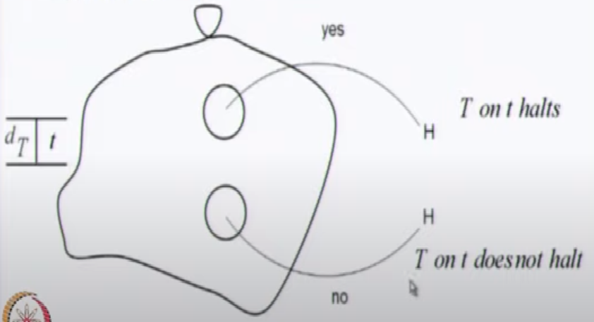
Halting Problem
Suppose the halting problem is decidable. Then there exists an algorithm (or TM) to solve this problem. We call this TM as ‘halt’. This machine ‘halt’ takes as input an encoding d_{T} of a TM with input t and tells whether T on t will halt or not. The state diagram as follows:

Slide 71
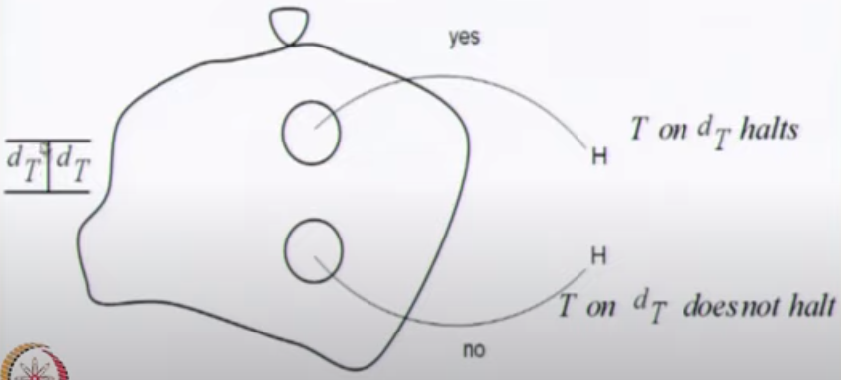
The machine ‘halt’ can be modified a little and we can think of a TM ‘copy halt’ as follows:

Slide 72
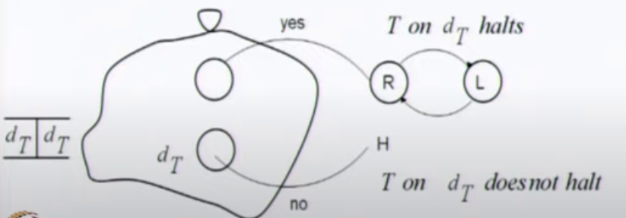
Now we can modify ‘copy halt’ a little and have a machine ‘contradict’ as follows:

Slide 73
does not halts halts
This is a contradiction.
Hence no such TM exists.
Therefore, halting problem of TM is undecidable.
contradict on d_{contradict}
halts does not halts

Slide 74
Computable Functions
A recursive function is defined in terms of itself.
The recursive definition of factorial is
n! = n * (n-1)! for n ≥1
2. The recursive definition of the exponential x^{n} is defined as
x^{n} = x * x^{n-1} for n ≥1
A recursive function can be generalized by defining it in addition to in terms of itself, possibly in terms of some other functions.
Such generalization defines primitive recursion.
Turing machine is viewed as a mathematical model of partial recursive function.

Slide 75
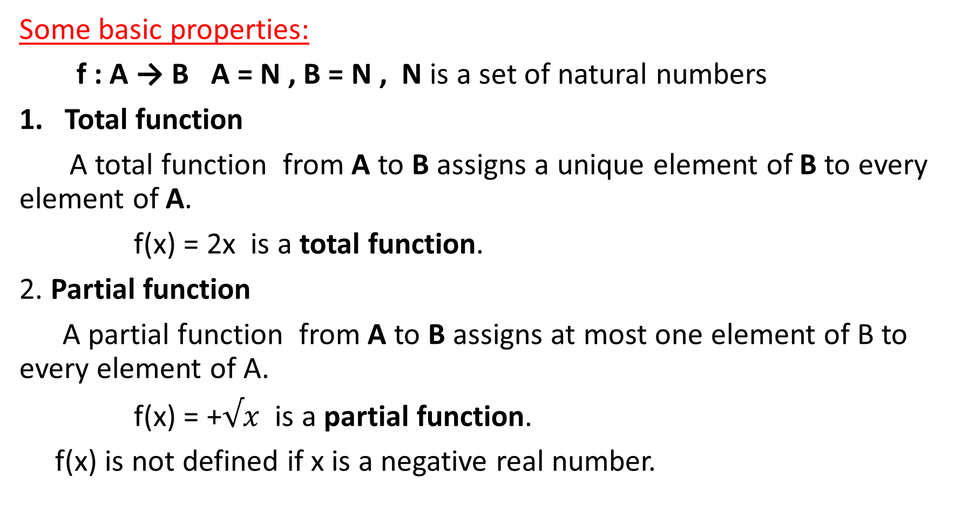
Some basic properties:
f : A → B A = N , B = N , N is a set of natural numbers
Total function
A total function from A to B assigns a unique element of B to every element of A.
f(x) = 2x is a total function.
2. Partial function
A partial function from A to B assigns at most one element of B to every element of A.
f(x) = +$√x$ is a partial function.
f(x) is not defined if x is a negative real number.

Slide 76
3. Function of k-variables
A function of k-variables is represented as f(x₁, x₂, . . . , x_{k}).
f(x₁, x₂) = x₁+2x₂ is a function of two variables.
4. Primitive recursive function
Some initial functions are taken as primitive recursive functions. These initial functions are:
a) Zero function
b) Successor function
c) Projection function
A function derived from combination / composition of primitive recursive functions is primitive recursive.

Slide 77
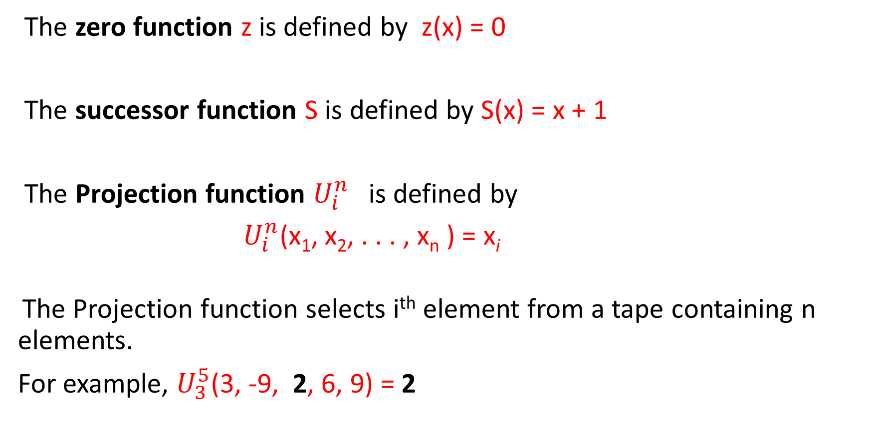
The zero function z is defined by z(x) = 0
The successor function S is defined by S(x) = x + 1
The Projection function $U_{i}^{n}$is defined by
$U_{i}^{n}$(x₁, x₂, . . . , x_{n} ) = x_{i}
The Projection function selects i^{th} element from a tape containing n elements.
For example, $U_{3}^{5}$(3, -9, 2, 6, 9) = 2

Slide 78
5. Composition
If f₁, f₂, . . . , f_{k} are partial functions of n variables, and g is a partial function of k variables, then the composition of g with f₁, f₂, . . . , f_{k} is a partial function of n variables defined by
g(f₁(x₁, x₂, . . . , x_{n}), f₂(x₁, x₂, . . . , x_{n}), . . . , f_{k}(x₁, x₂, . . . , x_{n}) )
For example:
If f₁(x, y) = x + y , f₂(x, y) = 3x , f₃(x, y) = xy and g(x, y, z) = x + y + 2z be functions over N, then
g(f₁(x, y), f₂(x, y), f₃(x, y)) = ( (x + y) + (3x) + 2(xy)) = (x + y + 3x + 2xy)
= (4x + y + 2xy)
If the composition g with f₁, f₂ and f₃ is by a function h, then
h(x, y, z) = 4x + y + 2xy

Slide 79
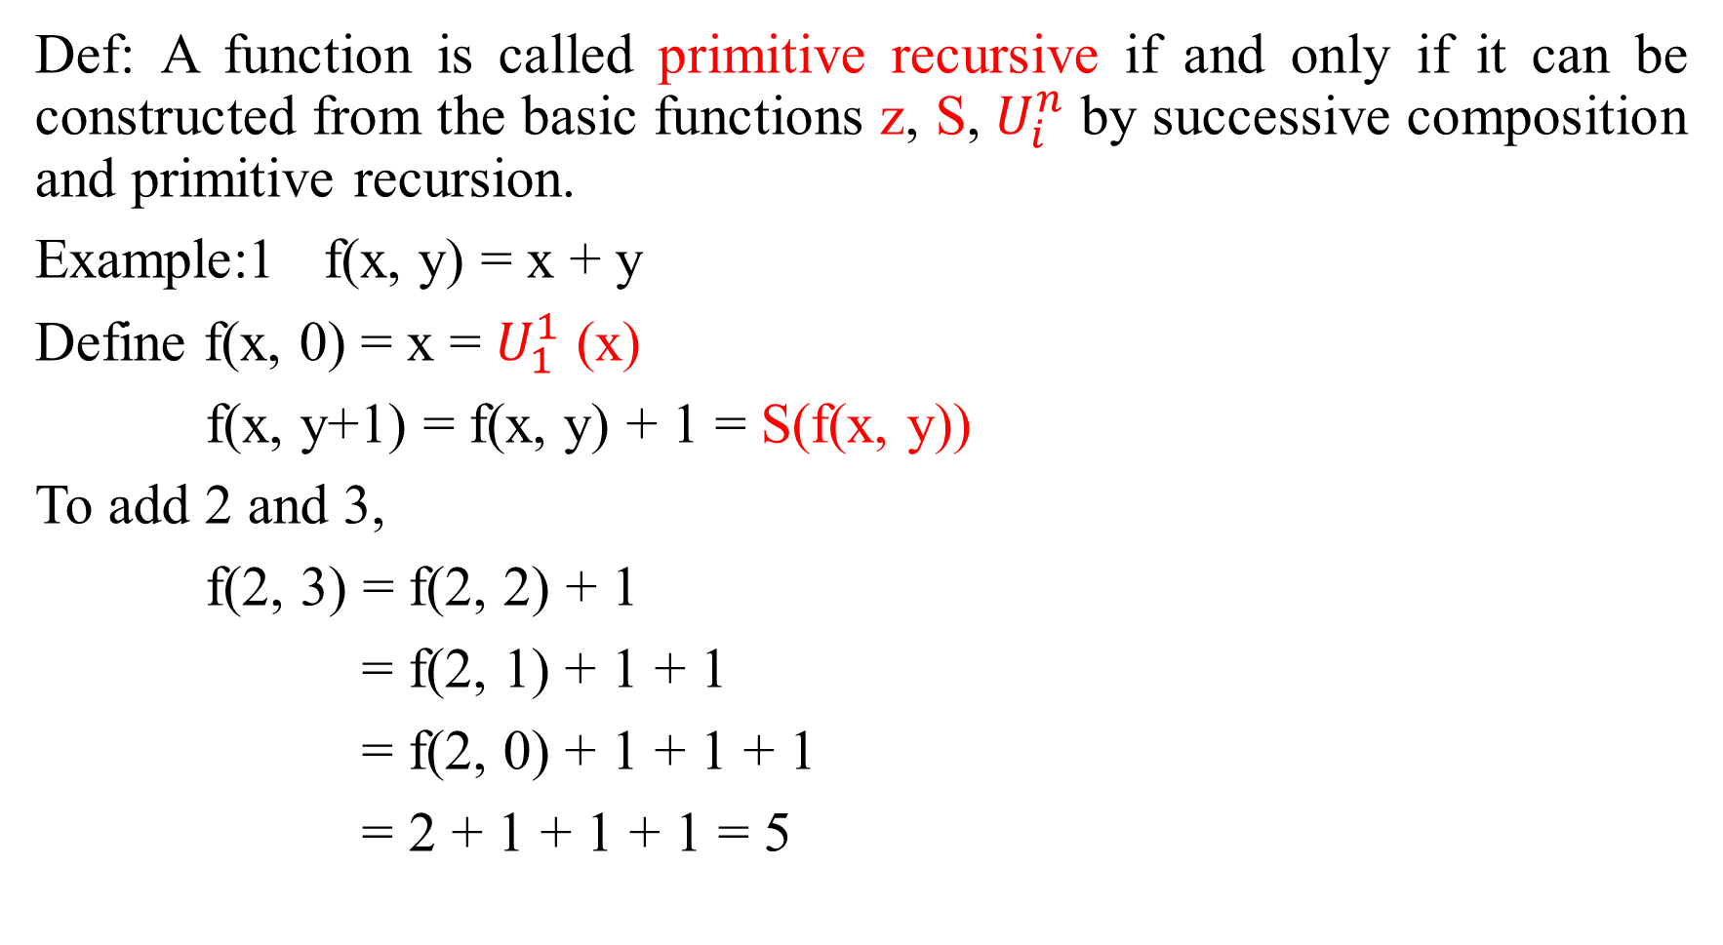
Def: A function is called primitive recursive if and only if it can be constructed from the basic functions z, S, $U_{i}^{n}$ by successive composition and primitive recursion.
Example:1 f(x, y) = x + y
Define f(x, 0) = x = $U_{1}^{1}$ (x)
f(x, y+1) = f(x, y) + 1 = S(f(x, y))
To add 2 and 3,
f(2, 3) = f(2, 2) + 1
= f(2, 1) + 1 + 1
= f(2, 0) + 1 + 1 + 1
= 2 + 1 + 1 + 1 = 5

Slide 80
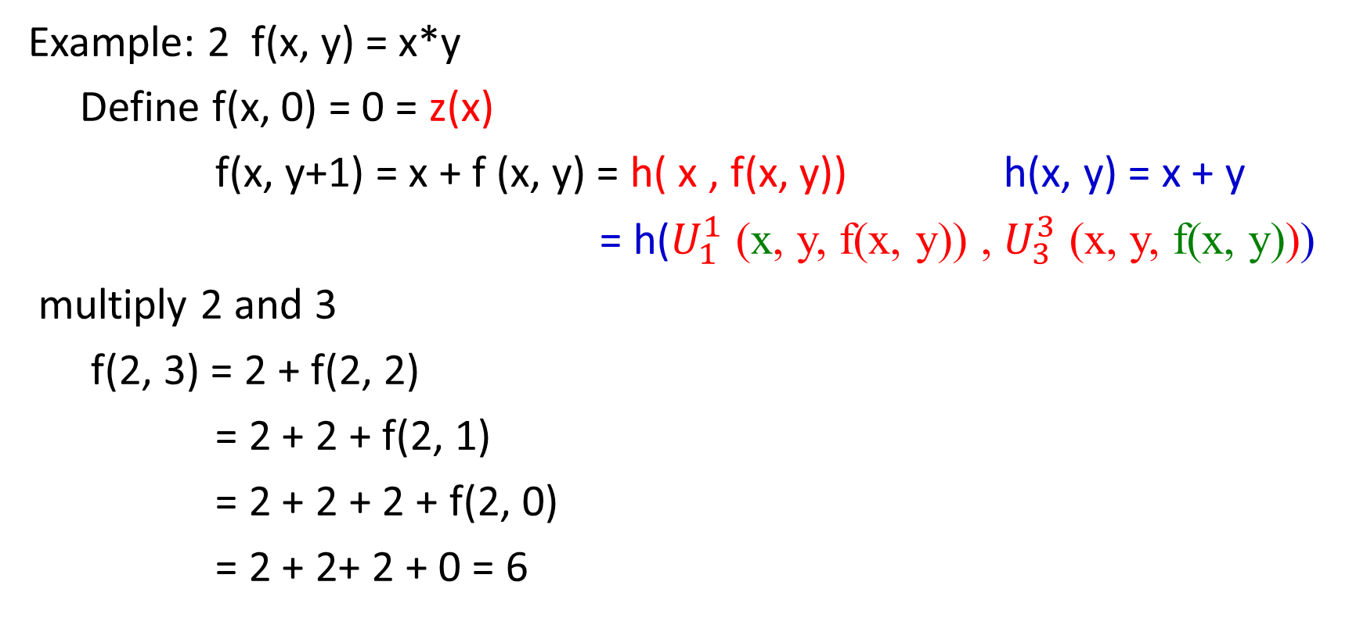
Example: 2 f(x, y) = x*y
Define f(x, 0) = 0 = z(x)
f(x, y+1) = x + f (x, y) = h( x , f(x, y)) h(x, y) = x + y
= h($U_{1}^{1}$ (x, y, f(x, y)) , $U_{3}^{3}$ (x, y, f(x, y)))
multiply 2 and 3
f(2, 3) = 2 + f(2, 2)
= 2 + 2 + f(2, 1)
= 2 + 2 + 2 + f(2, 0)
= 2 + 2+ 2 + 0 = 6

Slide 81
Example:3
f(x, y) = x – y if x ≥ 0
= 0 if x < 0
Now, we define the predecessor function
pred(0) = 0
pred(y + 1) = y
And from it, the subtraction function
subtr(x, 0) = x
subtr(x, y+1) = pred(subtr(x, y))

Slide 82
To prove that 5 – 3 = 2
subtr(5, 3) = pred(subtr(5, 2))
= pred(pred(subtr(5, 1)))
= pred(pred(pred(subtr(5, 0))))
= pred(pred(pred(5)))
= pred(pred(4))
= pred(3)
= 2

Slide 83
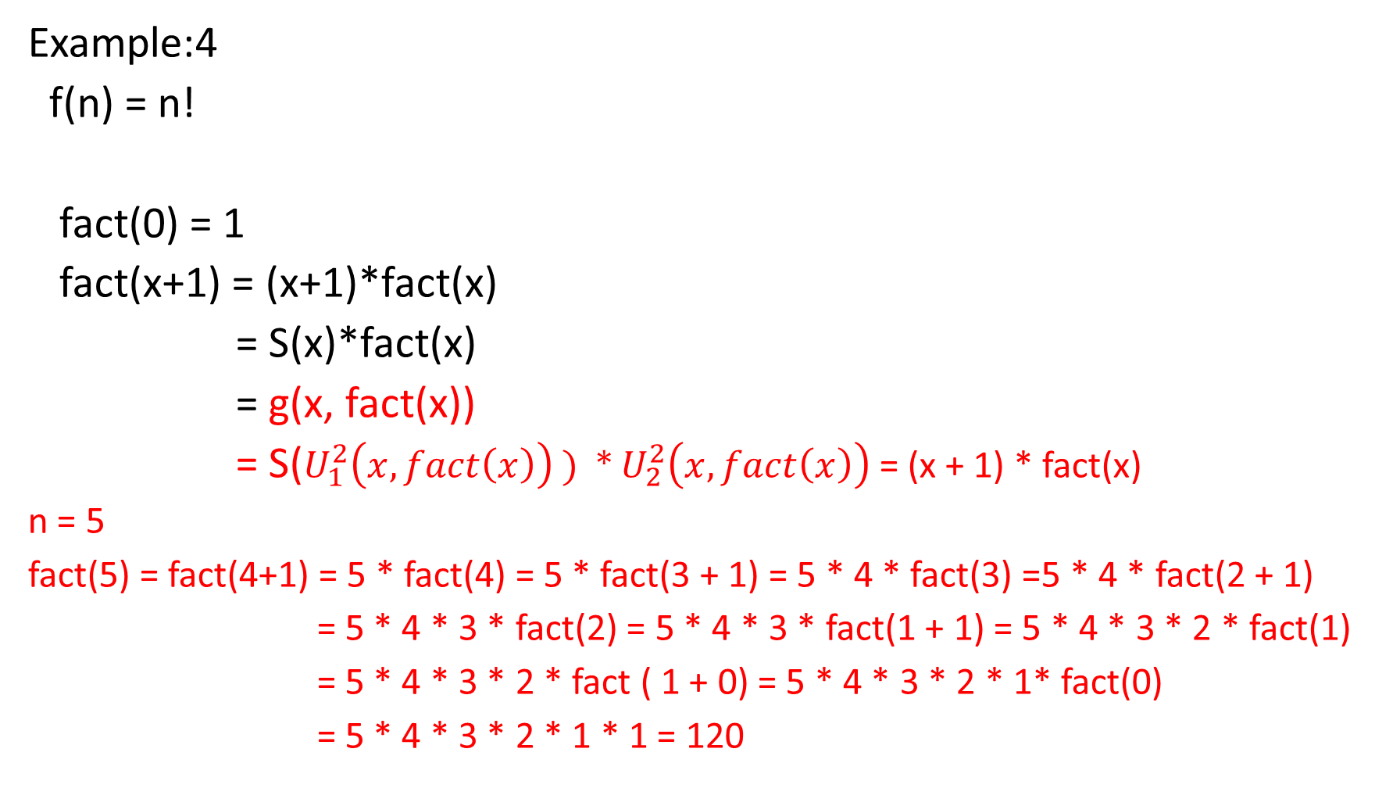
Example:4
f(n) = n!
fact(0) = 1
fact(x+1) = (x+1)*fact(x)
= S(x)*fact(x)
= g(x, fact(x))
= S($U_{1}^{2}\left(x, fact\left(x\right)\right) ) ∗$ $U_{2}^{2}\left(x, fact\left(x\right)\right)$ = (x + 1) * fact(x)
n = 5
fact(5) = fact(4+1) = 5 * fact(4) = 5 * fact(3 + 1) = 5 * 4 * fact(3) =5 * 4 * fact(2 + 1)
= 5 * 4 * 3 * fact(2) = 5 * 4 * 3 * fact(1 + 1) = 5 * 4 * 3 * 2 * fact(1)
= 5 * 4 * 3 * 2 * fact ( 1 + 0) = 5 * 4 * 3 * 2 * 1* fact(0)
= 5 * 4 * 3 * 2 * 1 * 1 = 120

Slide 84
Church-Turing Thesis
Alonzo Church (1903-1995) Lambda Calculus (λ – Calculus)
Emil Post (1897-1954) Post System
Kurt Godel (1906-1978) The incompleteness theorem (Godel number)
Alan Turing (1912-1954) Turing Machine

Slide 85
In 1936, Church created a method for defining functions called the lambda calculus (λ-calculus).
Within λ-calculus, he defined an encoding of the natural numbers called the Church numerals.
A function on the natural numbers is called λ-computable if the corresponding function on the Church numerals can be represented by a term of the λ-calculus (which is equivalent to using general recursive functions).
In the same 1936, before learning of Church's work, Alan Turing (Turing arrived at Princeton in 1936 and Alonzo Church was Turing's PhD Advisor) created a theoretical model for machines, now called Turing machines, that could carry out calculations from inputs by manipulating symbols on a tape.

Slide 86
Given a suitable encoding of the natural numbers as sequences of symbols, a function on the natural numbers is called Turing computable if some Turing machine computes the corresponding function on encoded natural numbers.
In computability theory, the Church–Turing thesis is a hypothesis ("thesis") about the nature of computable functions. In simple terms, the Church–Turing thesis states that a function on the natural numbers is computable in an informal sense (i.e., computable by a human being using a pencil-and-paper method, ignoring resource limitations) if and only if it is computable by a Turing machine.

